Slide 1
Arrange Pictures instantly.
Especially logos.
Ideal for arranging customer / product logos.
Created by Dr Nitin Paranjape and Raj Chaudhuri

Slide 2










Before
After
The macro hides the original images.
Here I am showing the images for illustration purpose only.

Slide 3
Before
After

Slide 4
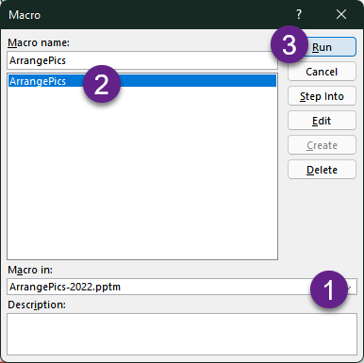
How to use this macro
Keep this file open
Go to your slide
Add pictures to the file
Select pictures
Choose View tab – Macros
Select macro ArrangePics
Click Run
Pictures will be arranged as SmartArt
Original pictures are hidden

Slide 5
Limitations
We have tested it with 200 pictures.
It works fine.
It may take time to process pictures.
For technical reasons, we have not given a progress bar.
Please be patient while the processing is going on.

Slide 6
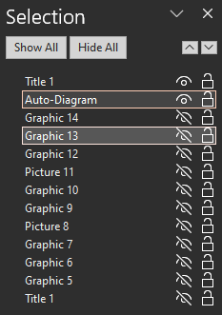
Test Slides
Use these to test the macro.
Once the macro runs, original images are hidden.
Go to Home tab – Selection – Selection Pane. Choose Show All.
The diagram is named as “Auto-Diagram”

Slide 7
















Multiple SVG icons

Slide 8
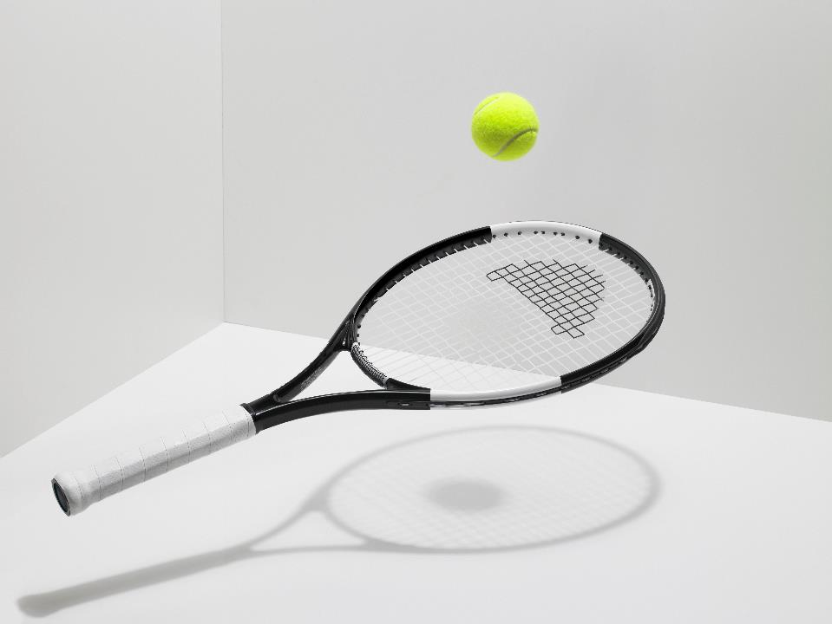





Multiple pictures

Slide 9





Mixed

Slide 10





Placeholder has SVG graphic

Slide 11
Thank You
Blog YouTube LinkedIn

